Slide 1
Northwind Database
Evaluating Business Hypotheses

Slide 2



Agenda & Objectives
Describe
Analyze
Recommend
Explain the hypotheses that were analyzed and their business implications
Investigate the results of our statistical analyses and what significant outcomes were found
Provide actionable business insights to increase profit and align the company’s future with customer needs.

Slide 3
Questions

Slide 4
Questions Analyzed
1
DISCOUNTS: Do discounts have an impact on the number of products that customers order? If so, at what levels?
2
FREIGHT COSTS: Does time of year have an impact on freight costs?
3
SUPPLIERS: Is there a difference in unit prices amongst supplier regions?
4
SHIPPING COMPANIES: Is there a difference in shipping company performance?

Slide 5
Findings

Slide 6
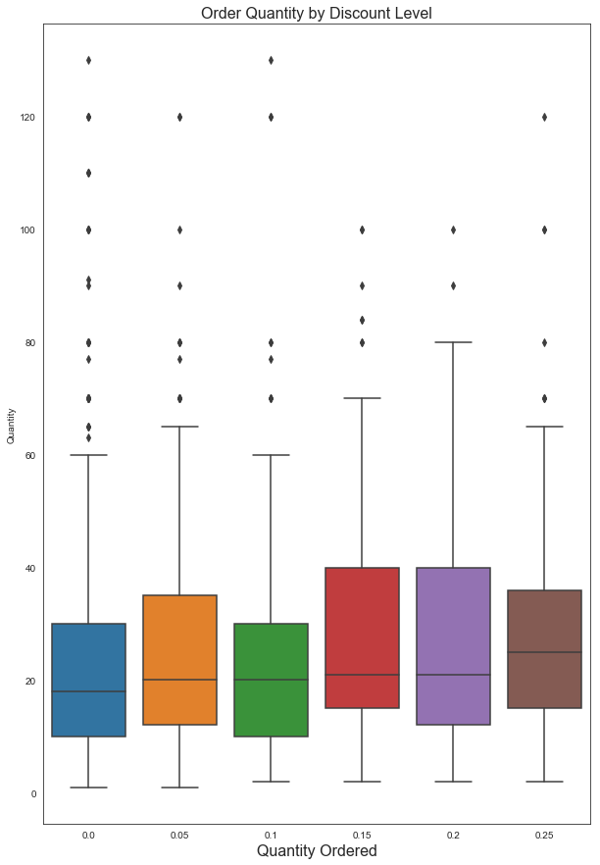
Discounts & Suppliers
Discounts
Implementing discounts, at every level but 10%, on orders had a statistically significant impact on increasing order quantities.
Important to note: Although the 10% discount was proven to be statistically insignificant, more tests should be done to rule out that it does not increase order quantities
Suppliers
The 11 supplier regions have no statistically significant impact on product pricing.
Product pricing is uniform across every region.

Slide 7
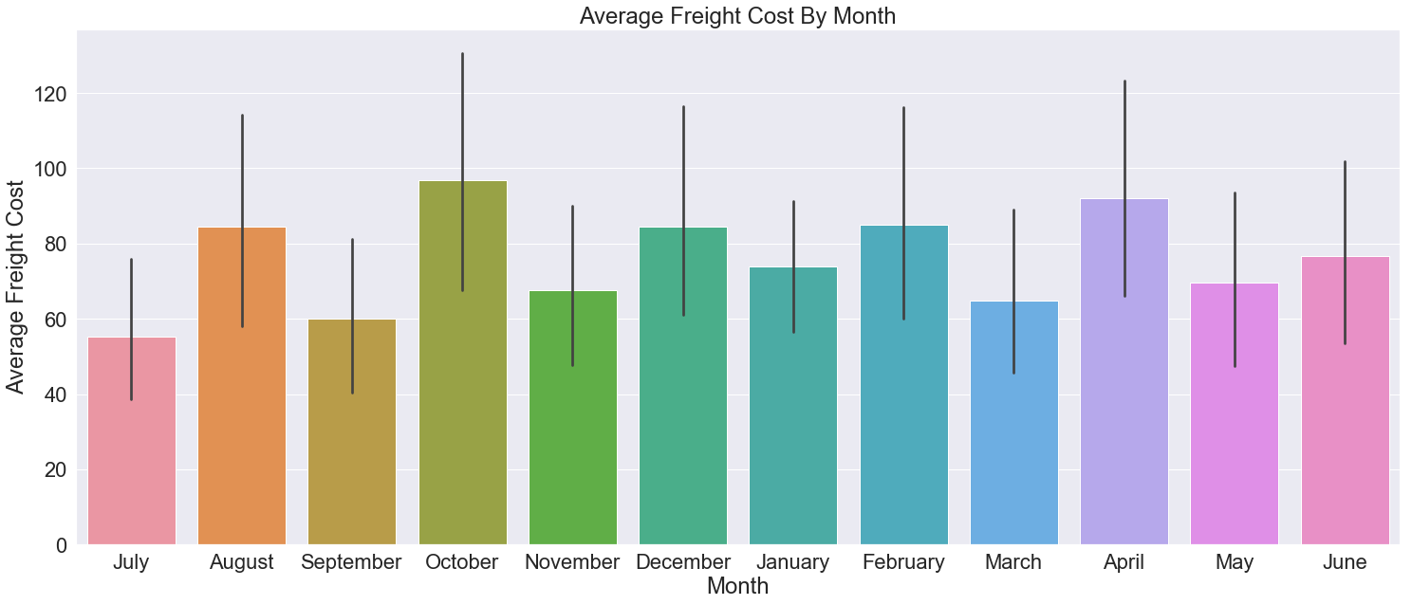
Freight Costs
The busiest time period of the year is January-April, while the slowest time period is May-July.
Cost fluctuates on a monthly basis.
However, our statistical tests showed that the changes in average freight prices each monthly are likely due to chance.

Slide 8
Recommendations

Slide 9
Recommendations
Discounts – Continue to promote discounts in order to increase customer order quantities
Freight Costs – Focus on logistical ease/customer expectations when planning shipments
Suppliers – Focus on operations and delivery efficiency when choosing suppliers

Slide 10
Next Steps
Customers – Evaluate what customers offer the greatest value and calculate if discounts can improve their order quantities of certain products
Employees – Analyze employee sales performance and reward those who are performing well

